Slide 1
What is Class in Oops ?
A class in Java is a set of objects which shares common characteristics/ behavior and common properties/ attributes. It is a user-defined blueprint or prototype from which objects are created.
Class is not a real-world entity. It is just a template or blueprint or prototype from which objects are created.
Class does not occupy memory.
Class is a group of variables of different data types and a group of methods.
A Class in Java can contain:
Data member
Method
Constructor
Nested class
Interfaces

Slide 2
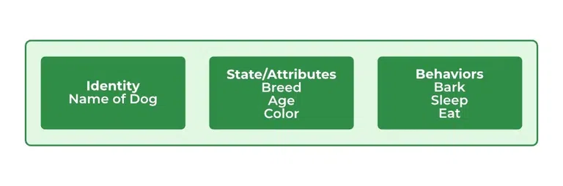
What is object in Oops ?
An object is a real-world entity.
The object is an entity which has state and behavior.
The object is an instance of a class.
The object is occupy space in the memory as it is physical entity.
State : It is represented by attributes of an object.
Behavior : It is represented by the methods of an object.
Identity : It gives a unique name to an object and enables one object to interact with other objects.

Slide 3
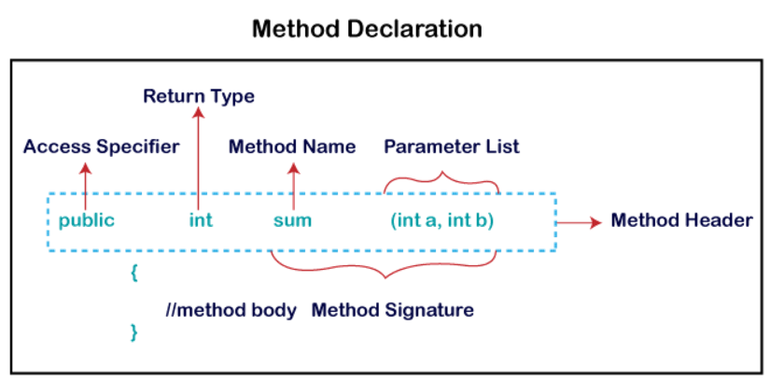
METHOD in java?
A method is a block of code or collection of statements or a set of code grouped together to perform a certain task or operation.
It provides the reusability of code.

Slide 4
constructor in java?
In Java, a Constructor is a block of codes similar to the method.
It is a special type of method which is used to initialize the object.
It is called when an instance of the class is created.
It can be used to set initial values for object attributes:
At the time of calling constructor, memory for the object is allocated in the memory.

Slide 5
Naming conventional in java?
Class
It should start with the uppercase letter.
Method
It should start with lowercase letter.
Variable
It should start with a lowercase letter such as id, name.
Constructor
It should be a noun such as Color, Button, System, Thread, etc.
It should be a verb such as main(), print(), println().
If the name contains multiple words, start it with a lowercase letter followed by an uppercase letter such as actionPerformed().
It should not start with the special characters like & (ampersand), $ (dollar), -(dash)
If the name contains multiple words, start it with the lowercase letter followed by an uppercase letter such as firstName, lastName.
Avoid using one-character variables such as x, y, z.
Constructor name must be the same as its class name.
A Constructor must have no explicit return type.
A Java constructor cannot be abstract, static, final, and synchronized.
Constant
It should be in uppercase letters such as RED, YELLOW.
If the name contains multiple words, it should be separated by an underscore(_) such as MAX_PRIORITY.
It may contain digits but not as the first letter.
It may contain digits but not as the first letter.

Slide 6
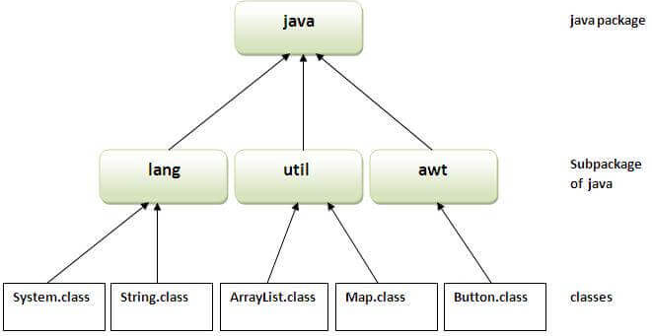
package in java?
A java package is a group of similar types of classes, interfaces and sub-packages.
Preventing naming conflicts. For example there can be two classes with name Employee in two packages, college.staff.cse.Employee and college.staff.ee.Employee
Java package provides access protection.
To use a class or a package from the library, you need to use the import keyword.

Slide 7

Access modifier in java?
Access modifiers help to restrict the scope of a class, constructor, variable, method, or data member.
There are four types of access modifiers available in Java:
Private: The access level of a private modifier is only within the class. It cannot be accessed from outside the class.
Default: The access level of a default modifier is only within the package. It cannot be accessed from outside the package. If you do not specify any access level, it will be the default.
Protected: The access level of a protected modifier is within the package and outside the package through child class. If you do not make the child class, it cannot be accessed from outside the package.
Public: The access level of a public modifier is everywhere. It can be accessed from within the class, outside the class, within the package and outside the package.

Slide 8
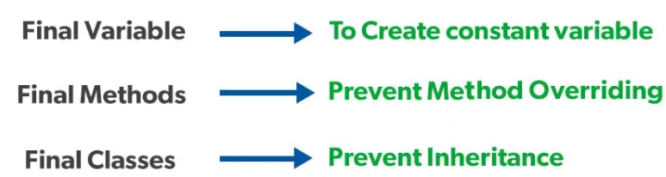
Keywords in java?
Static :
The static keyword in Java is mainly used for memory management.
The static keyword in Java is used to share the same variable or method of a given class.
The users can apply static keywords with variables, methods, blocks, and nested classes.
The static keyword belongs to the class rather than an instance of the class.
To create a static member(block, variable, method, nested class), precede its declaration with the keyword static.
Final :
The final keyword in java is used to restrict the user.

Slide 9
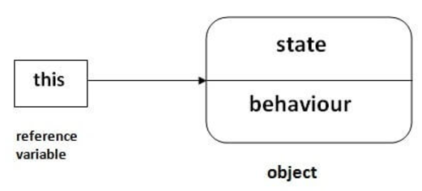
Keywords in java?
This :
In Java, this is a reference variable that refers to the current object.
Super :
The super keyword in Java is a reference variable which is used to refer immediate parent class object.
The most common use of super keyword is to eliminate the confusion between superclasses and subclasses that have methods with the same name

Slide 10
Method overloading & overriding
Method overloading :
Method overloading in Java is the feature that enables defining several methods in a class having the same name but with different parameters.
There are two ways to overload the method in java : By changing number of arguments. By changing the data type.
In Java, Method Overloading is not possible by changing the return type of the method only.
Method overriding :
If subclass (child class) has the same method as declared in the parent class, it is known as method overriding in Java.
Both the superclass and the subclass must have the same method name, the same return type and the same parameter list.
We cannot override the method declared as final and static.
We should always override abstract methods of the superclass.

Slide 11
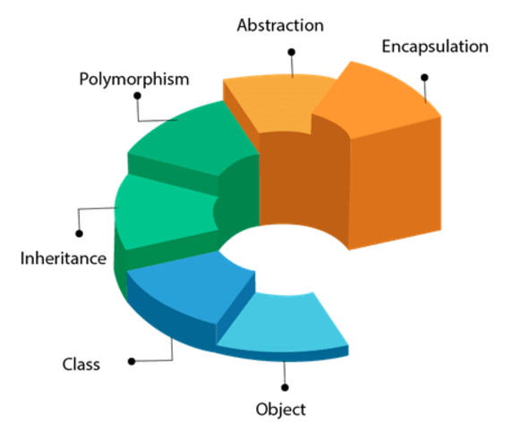
Oops concepts
Object-Oriented Programming is a methodology or paradigm to design a program using classes and objects.

Slide 12
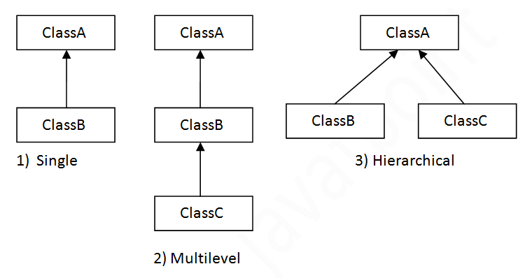
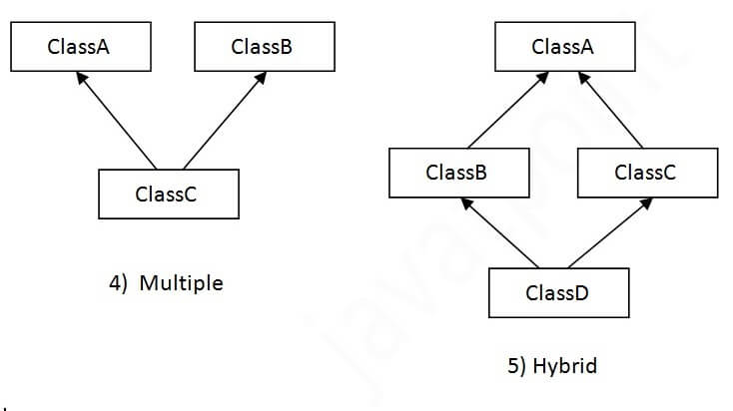
Inheritance in oops
Inheritance in Java is a mechanism in which one object acquires all the properties and behaviors of a parent object.
It is an important part of OOPs (Object Oriented programming system).
Inheritance represents the IS-A relationship which is also known as a parent-child relationship.
Note: Multiple inheritance is not supported in Java through class.

Slide 13
polymorphism in oops
Polymorphism in Java is a concept by which we can perform a single action in different ways.
The word "poly" means many and "morphs" means forms. So polymorphism means many forms.
There are two types of polymorphism in Java: compile-time polymorphism, runtime polymorphism.
compile-time polymorphism : In Java, method overloading is used to achieve compile-time polymorphism.
It is also known as static polymorphism.
A class can have multiple methods with the same name but different in parameters.
runtime polymorphism : It is also known as Dynamic Method Dispatch.
It is a process in which a call to an overridden method is resolved at runtime rather than compile-time.

Slide 14
abstraction in oops
Abstraction is a process of hiding the implementation details and showing only functionality to the user.
Abstraction in Java is the process in which we only show essential details/functionality to the user. The non-essential implementation details are not displayed to the user.
abstraction is achieved by interfaces and abstract classes. We can achieve 100% abstraction using interfaces.

Slide 15
encapsulation in oops
Encapsulation in Java is a process of wrapping code and data together into a single unit.
Java Encapsulation is a way of hiding the implementation details of a class from outside access and only exposing a public interface that can be used to interact with the class.
In Java, encapsulation is achieved by declaring the instance variables of a class as private, which means they can only be accessed within the class.
Now we can use setter and getter methods to set and get the data in it.

Slide 16
Abstract class in oops
An abstract class in Java acts as a partially implemented class that itself cannot be instantiated.
It exists only for subclassing purposes, and provides a template for its subcategories to follow.
An abstract class must be declared with an abstract keyword.
It can have abstract and non-abstract methods.
Abstract methods are declared to have no body.
It cannot be instantiated.
It can have constructors and static methods also.
It can have final methods which will force the subclass not to change the body of the method.

Slide 17
interface in java
An interface in Java is a blueprint of a class. It has static constants and abstract methods.
It is used to achieve abstraction and multiple inheritances in Java.
Interfaces can have abstract methods and variables. It cannot have a method body.
Java Interface also represents the IS-A relationship.
It cannot be instantiated just like the abstract class.
Since Java 8, we can have default and static methods in an interface.
An interface is declared by using the interface keyword.

Slide 18
Aggregation in oops
If a class have an entity reference, it is known as Aggregation.
Aggregation represents HAS-A relationship.
It is a unidirectional association i.e. a one-way relationship.
Aggregation is a type of association that represents a relationship where one class is a collection or container of another class.

Slide 19
Inheritance vs aggregation
Method overloading vs method overriding
Encapsulation vs abstraction
Method vs constructor
Abstract class vs interface

